Slide 1
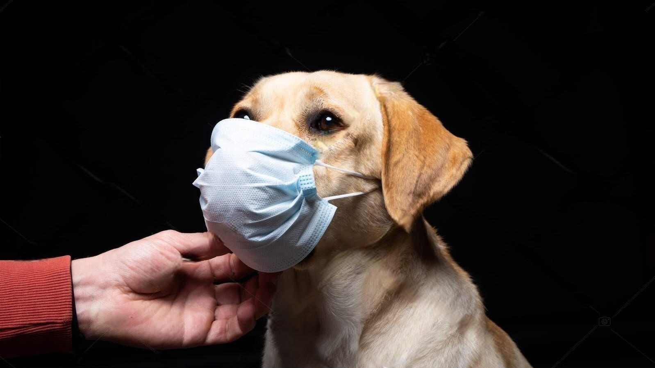


PET-ME
A pet health management system
By: Kenny Cheng

Slide 2
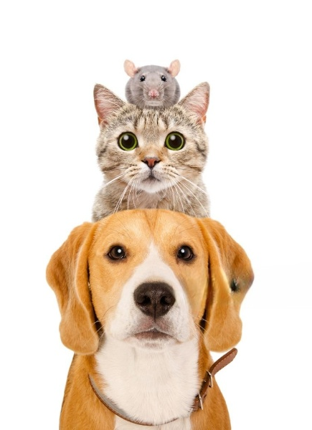
Special thanks to
Pete Carapetyan
Oğulcan Kendirci
Spring Security v3 (SSV3) teammates:
Sri Medicherla
Hayden Huffman
Karen Dillehay

Slide 3
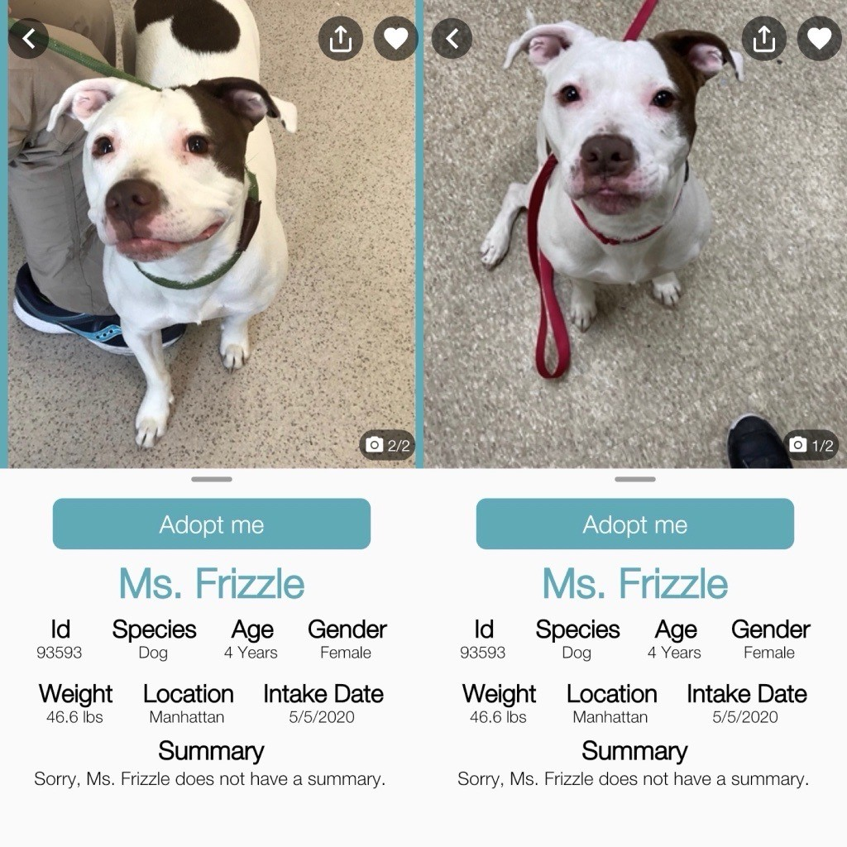

Why PET-ME?
Volunteer at the NYC’s Animal Shelter - www.nycacc.org/
Animal handler at the mobile vaccination clinics
Most pet owners forget their pets’ booster
Others don’t know about the benefits and side effects of the administered vaccine

Slide 4
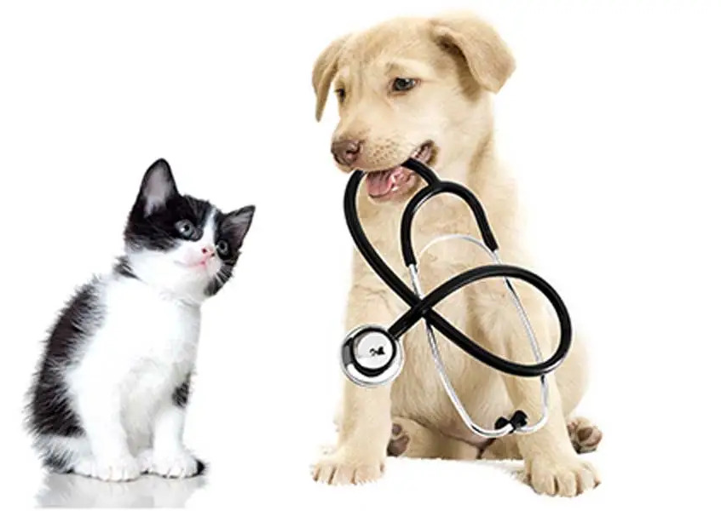
Objectives
Create a user-friendly app that will allow users track all health-related records for their pets.
Educate the users on the vaccines’ effectiveness in preventing specific diseases.
Also educate users on possible side effects for certain medications so that users know what to be in the look-out for.

Slide 5




User Workflow (used to drive database schema)
User
Animals
Medications
Authentication
Registration
Authority
Role
User role by default
Is this the same person?
Notes:
Authorities is an object type used to restrict access to features. The features are grouped by roles

Slide 6





Integrated Development Environments (IDEs)

Slide 7








Technologies
Server language
Java 17
Framework
Spring Boot
Database
H2
MySQL
Model-View-Controller (MVC)
Thymeleaf
Security
Spring Security (Java 17 version)
JSON Web Tokens (JWTs)

Slide 8




Technologies
User Interface
HTML
CSS/JS
Deployment
Railways
Dependency Management
Maven
Source Control
GitHub

Slide 9

Future releases/updates
Mobile friendly (through PWA)
Ability to upload records from vet visits
Synchronization to phone calendar for reminders of the medication due date and vet visits (through open-source APIs)
Support for other languages (through Google API)
Parse the information directly into pet profile

Slide 10

Demo Time!

